Slide 1
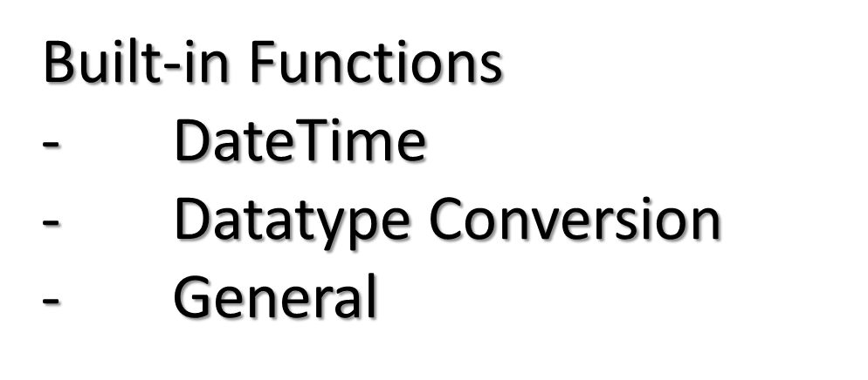

Slide 2
Datetime functions operate on values of the DATE data type.
All datetime functions return a datetime or interval value of the datatype, except the MONTHS_BETWEEN function, which return a number
SYSDATE is a date function that returns the current date and time.
This function can be used in any SQL statement.
SYSDATE Function

Slide 3
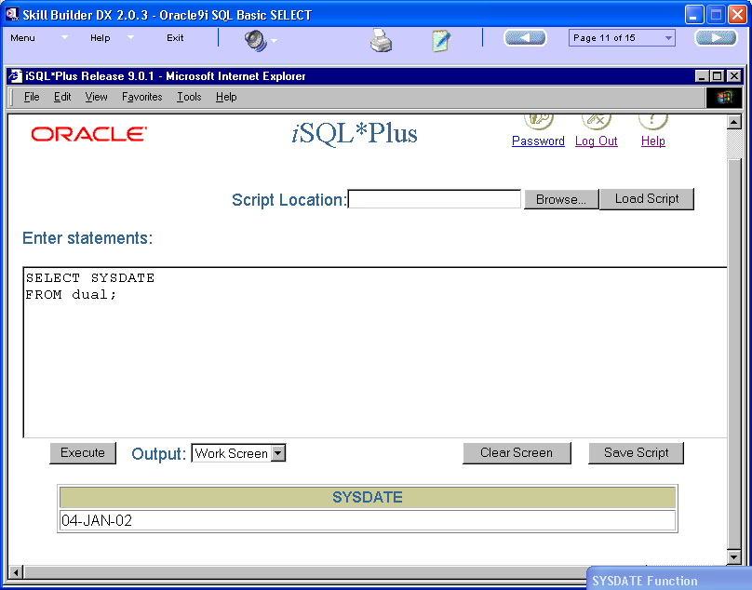

Slide 4
The DUAL table is a special one row table present by default and a useful feature of the Oracle server that behaves like a dummy table
The DUAL table consists of one column named DUMMY.
The datatype of this column is VARCHAR2.
This table can be used to understand the built-in functions
Since SQL is a structured language, it requires a FROM clause, thus we can make use of dual to test built-in functions without creating an actual table

Slide 5
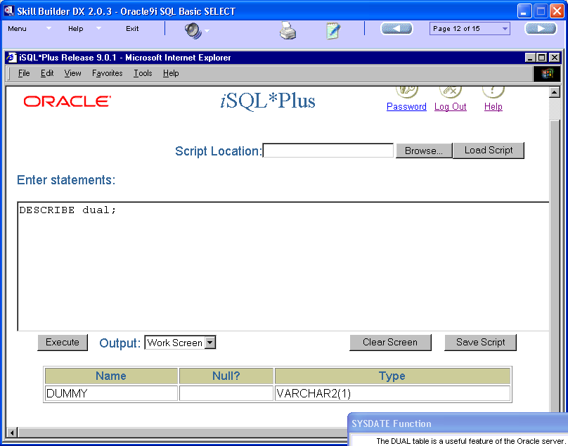

Slide 6
FUNCTIONS | DESCRIPTION
MONTHS_BETWEEN | Finds number of months between two dates
ADD_MONTHS | Adds calendar months to date
NEXT_DAY | Finds the next day of the date specified
LAST_DAY | Finds last day of the month
ROUND | Rounds Date
TRUNC | Truncates Date
CURRENT_DATE | Returns the current date
CURRENT_TIMESTAMP | Returns the current date & time
SYSTIMESTAMP | Returns system’s date & time

Slide 7
Syntax: MONTHS_BETWEEN(date1, date2)
MONTHS_BETWEEN finds the number of months between two dates.
The result can be positive or negative.
If date1 is before date2, the result is negative.
If date1 is after date2, the result is positive.
While calculation, it takes into consideration upto the seconds that the two specified dates are apart

Slide 8
1. SELECT MONTHS_BETWEEN('12-JAN-12','12-FEB-12')
FROM dual;
Result = -1
2. SELECT MONTHS_BETWEEN('12-FEB-12','12-FEB-12')
FROM dual;
Result = 0
3. SELECT MONTHS_BETWEEN('12-FEB-12','12-JAN-12')
FROM dual;
Result = 1

Slide 9
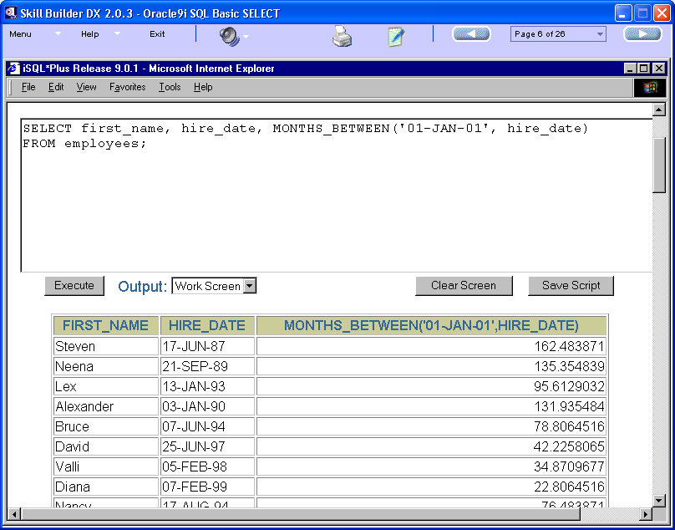

Slide 10
Syntax: ADD_MONTHS(date, n)
The ADD_MONTHS function adds a number of calendar months to a specified date.
The number specified (n) in the function must be an integer and can be negative.
For example

Slide 11
1. SELECT ADD_MONTHS('01-JAN-12',3)
FROM dual;
Result: 01-APR-12
2. SELECT ADD_MONTHS('01-JAN-12',-3)
FROM dual;
Result: 01-OCT-11

Slide 12
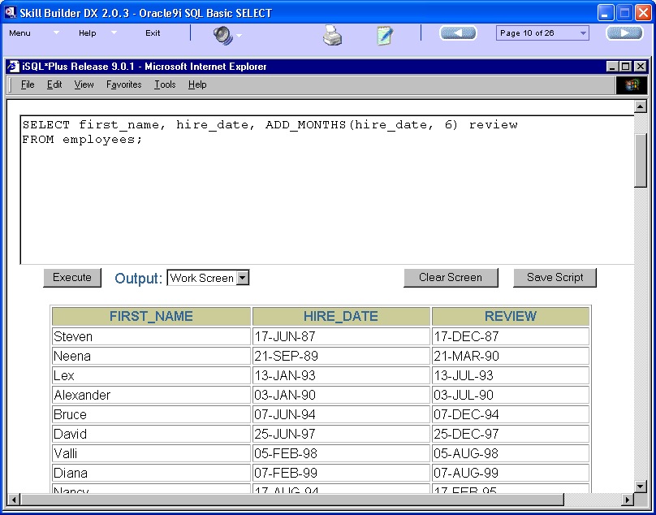

Slide 13
Syntax: NEXT_DAY(date, char|number)
The NEXT_DAY function returns the date of the next specified day of the week from a given date.
In this function, we can specify the day of the week
  as a character string, such as ‘Friday’,
  or as a number with 1 representing Sunday and 7 representing Saturday.

Slide 14
Taking SYSDATE =16-MAR-12
1. SELECT NEXT_DAY(SYSDATE,'Friday')
FROM dual;
Result: 23-MAR-12
OR
2. SELECT NEXT_DAY(SYSDATE,6)
FROM dual;
Result: 23-MAR-12

Slide 15
Syntax: LAST_DAY(date)
The LAST_DAY function finds the date of the last day of the month, for a specified date.
Example
SELECT LAST_DAY('01-FEB-12')
FROM dual;
Returns : 29-FEB-12

Slide 16
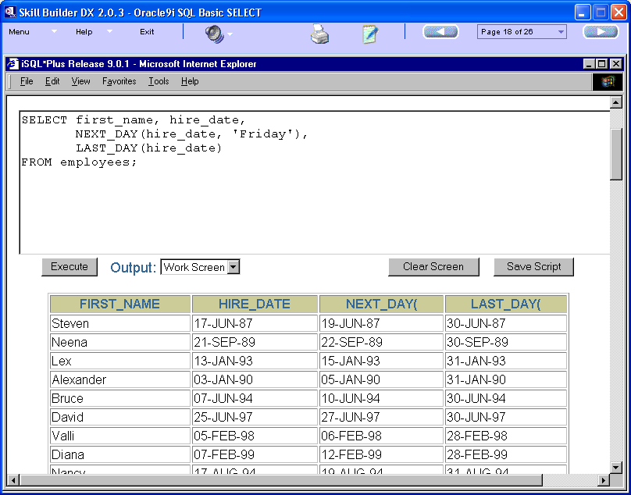

Slide 17
1. SELECT CURRENT_DATE
FROM dual;
Result: 16-MAR-12
2. SELECT CURRENT_TIMESTAMP
FROM dual;
Result: 16-MAR-12 12.00.36.156000 PM +05:30
3. Using these functions in SQL statements
SELECT *
FROM Employees
WHERE dob = CURRENT_DATE;

Slide 18
In Oracle/PLSQL, the systimestamp function returns the current system date and time (including fractional seconds and time zone) on your local database.
The syntax for the systimestamp function is:
systimestamp
Applies To: Oracle 9i, Oracle 10g, Oracle 11g
Example:
SELECT systimestamp
FROM dual;
Returns: 16-MAR-12 12.05.01.875000 PM +05:30

Slide 19
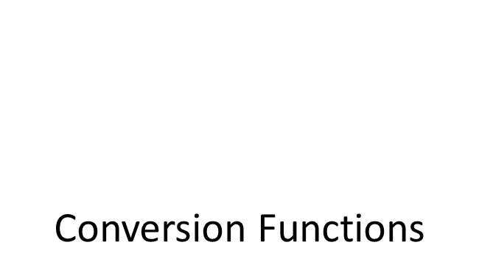

Slide 20
Implicit datatype conversion means that the Oracle server automatically converts data from one datatype to another.
However, explicit datatype conversion is recommended to ensure readability of your SQL statements.
The three most common data types used by an Oracle database are NUMBER, VARCHAR2, and DATE.
Oracle converts certain data types implicitly.
For example, when a condition compares a character value and a numeric value, the Oracle database implicitly converts the character value to a number value.

Slide 21
When comparing a character value with a number value, Oracle converts the character data to number.
When comparing a character value with a date value, Oracle converts the character data to date.
For example, the literal ’10’ had the datatype CHAR. Oracle implicitly converts it to the NUMBER datatype if it appears in a numeric expression.
Example
SELECT 10 + ‘20’
FROM dual;
Returns: 30

Slide 22
The Oracle server can convert the VARCHAR2 or CHAR datatype to the NUMBER or DATE datatype.
Alternatively, the server can also convert the NUMBER or DATE datatype to the VARCHAR2 datatype.
Implicit character to number conversions succeed only if the character string represents a valid number.
Implicit character to date conversions succeed only if the character string has a specified default format, such as DD-MON-RR.
VARCHAR2 OR CHAR | NUMBER
VARCHAR2 OR CHAR | DATE
NUMBER | VARCHAR2
DATE | VARCHAR2

Slide 23
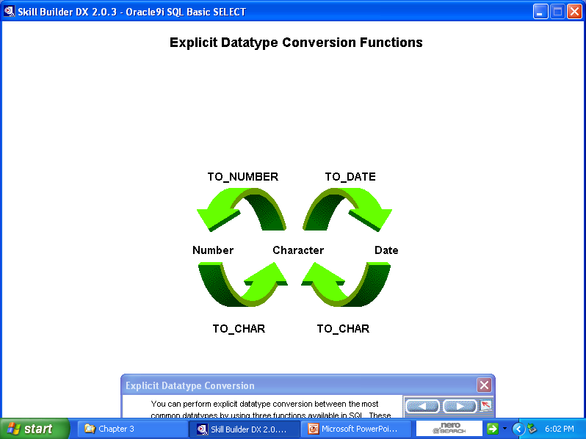
Alternatively, you can explicitly convert one datatype to another.
Conversion functions are used to explicitly convert the data to the expected datatype

Slide 24
The TO_CHAR conversion function converts a number or date to a VARCHAR2 character string with the format model that you specify.
A format model (format) is a character literal that describes the format of how the date or number will be displayed.
Syntax:
  TO_CHAR(number|date[,format_model])

Slide 25
The common default format for displaying dates stored in the Oracle 9i server is DD-MON-YY.
If you want to display dates in a different format, you can use the TO_CHAR function to convert a date into a specified character format
When you specify a format model in the TO_CHAR function, you enclose the format model in single quotation marks.
The format model is case-sensitive and can include any valid date format element.
We can separate the date value from the format model with a comma.

Slide 26
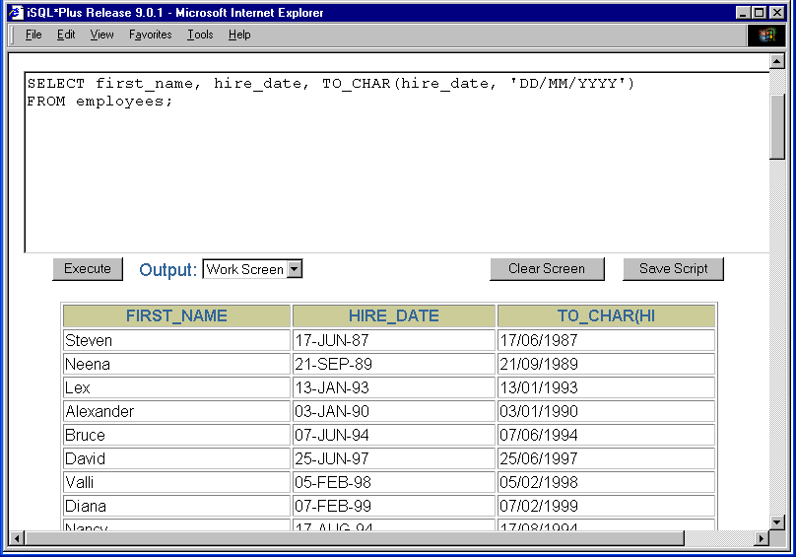

Slide 27
The format model can include any valid date format element. The common format model elements are displayed.
These elements can be combined into a format model of you choice.
Format | Description
YYYY | Full year in numbers
YEAR | Year spelled out
MM | Two digit value for month (01-12)
MONTH | Full-name of month
MON | Three letters of the month (JAN,FEB,….,DEC)
DY | Three letters for the day of week (SUN,MON,…,SAT)
DAY | Full name of the day(Sunday, Monday,…..)

Slide 28
There are many valid date formats that we can use to create a date format model.
Format model elements representing days and weeks are displayed.
Format | Description
WW or W | Week of year or month
DDD | Day of the year
DD | Day of the month
MONTH | Full-name of month
D | Day of the week
J | Julian day: the number of days since 31st December 4713 B.C.

Slide 29
1. SELECT TO_CHAR(hire_date, ‘DD/MM/YEAR')
FROM employees;
Result: 17/10/Twenty eleven
2. SELECT TO_CHAR(hire_date, 'DD/MM/YYYY')
FROM employees;
Result: 17/10/2012

Slide 30
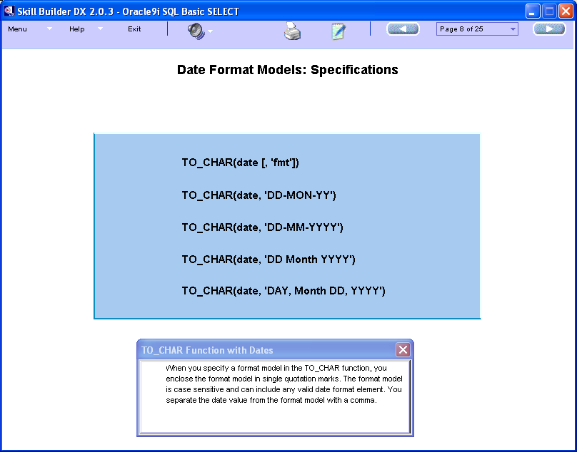

Slide 31
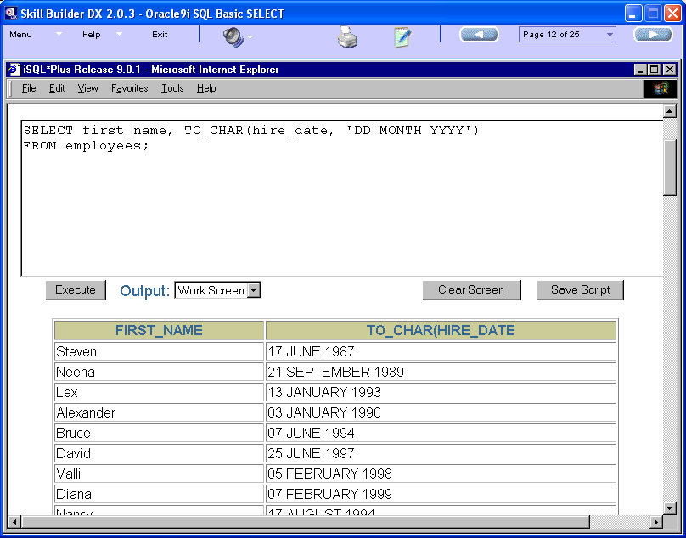

Slide 32
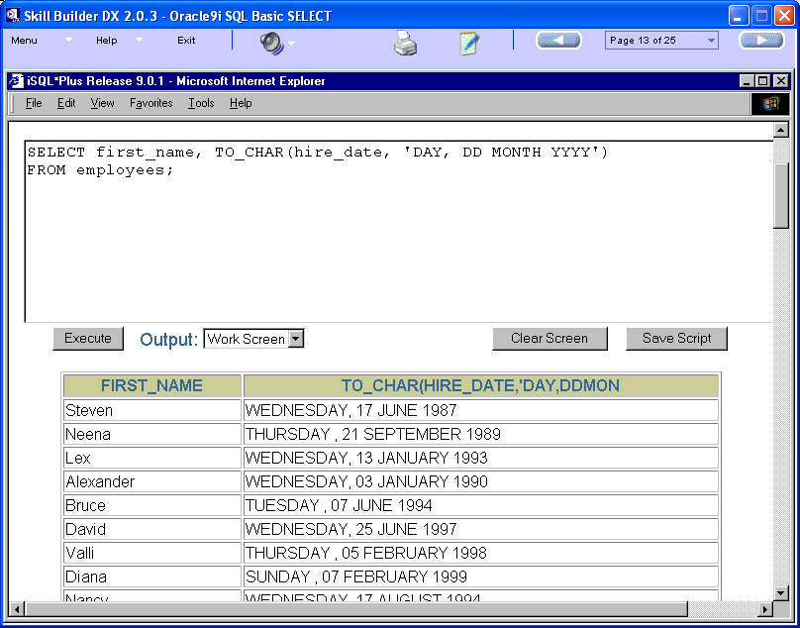

Slide 33
Example –
SELECT first_name, TO_CHAR(salary, ’99999.00’)
FROM employees;
In the example displayed, the TO_CHAR function accepts two arguments.
  First is the column salary.
  The second argument is the format model that you use to display the salary value.

Slide 34
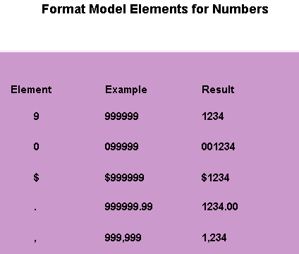

Slide 35
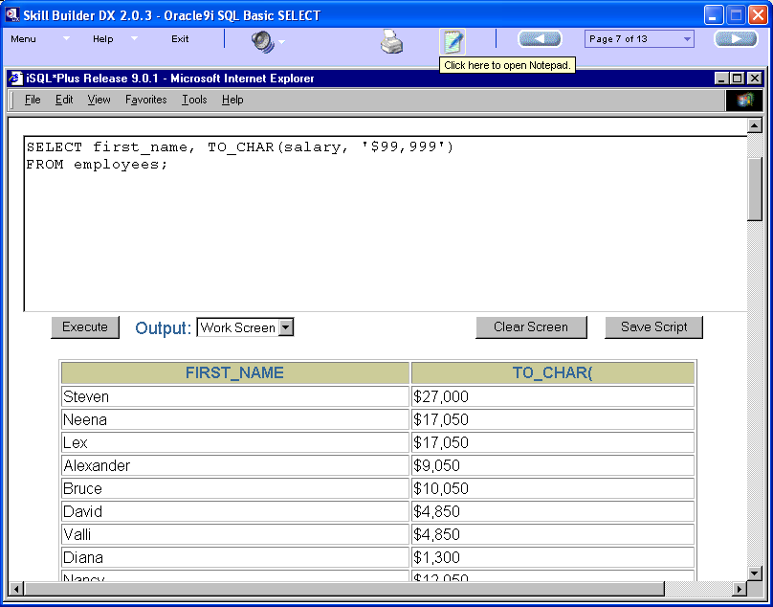

Slide 36
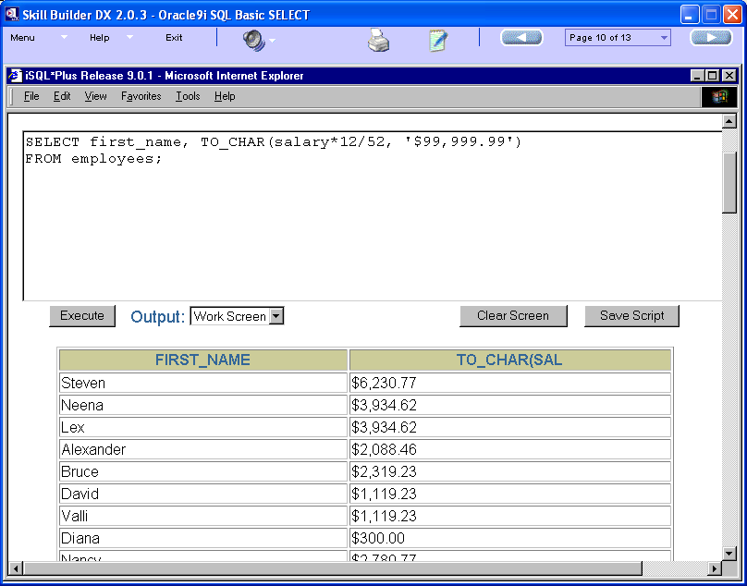

Slide 37
To convert a character string to a number, you use the TO_NUMBER function.
We have to specify two input arguments in the function. First is the character string that you want to convert and second is an optional format model.
The format model provides information about how to interpret the character string.
Syntax -
TO_NUMBER(char[,format_model])

Slide 38
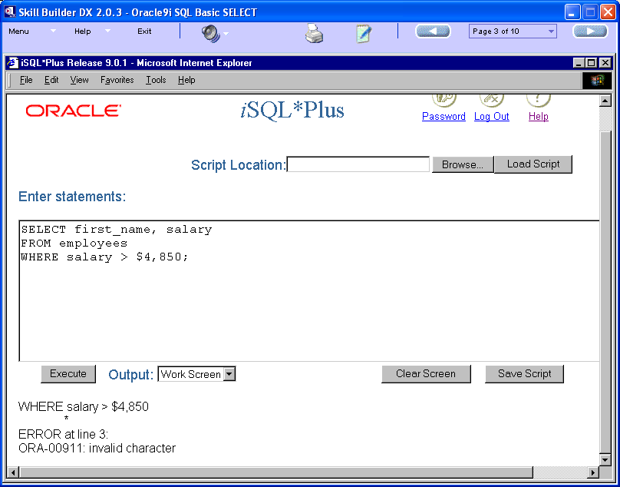

Slide 39
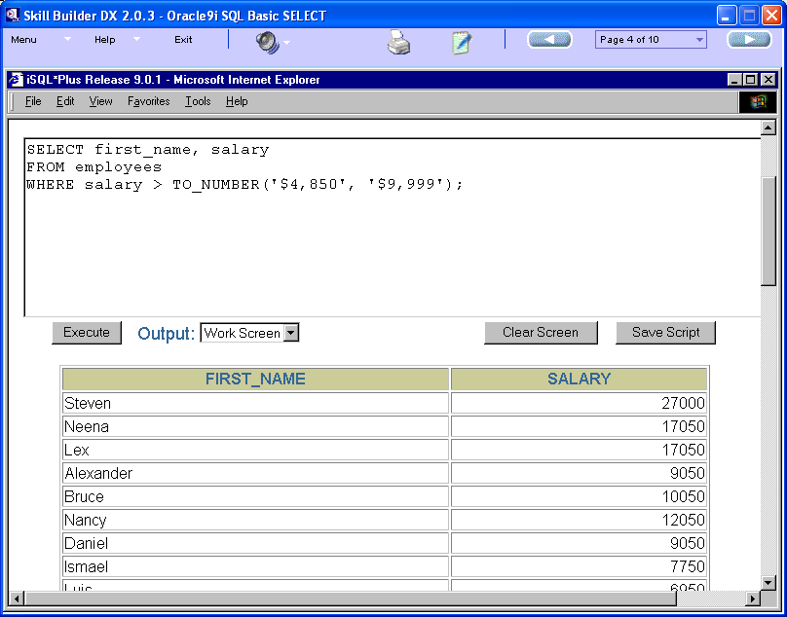

Slide 40
The TO_DATE conversion function converts a character string to a date value according to a format that you specify.
If you do not specify a format, the default format DD-MON-RR is assumed and the character string must match that format.
Syntax -
TO_DATE(char[,format_model])

Slide 41
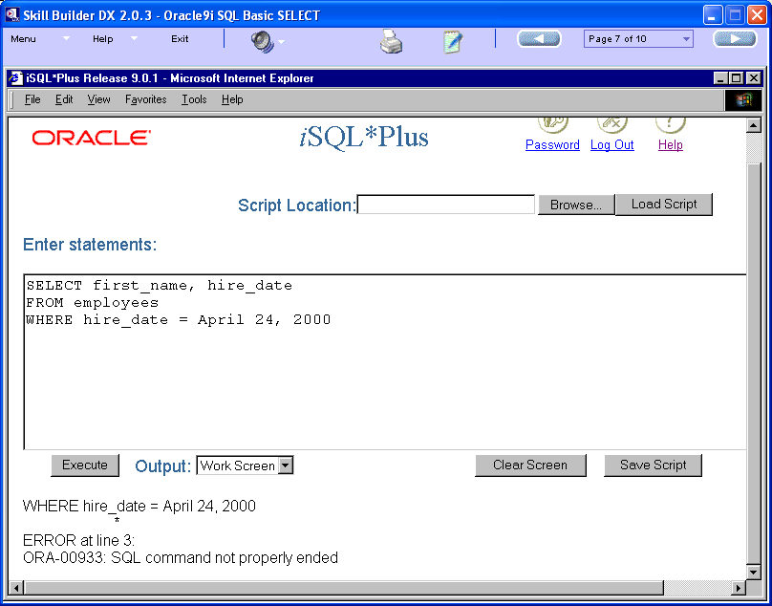

Slide 42
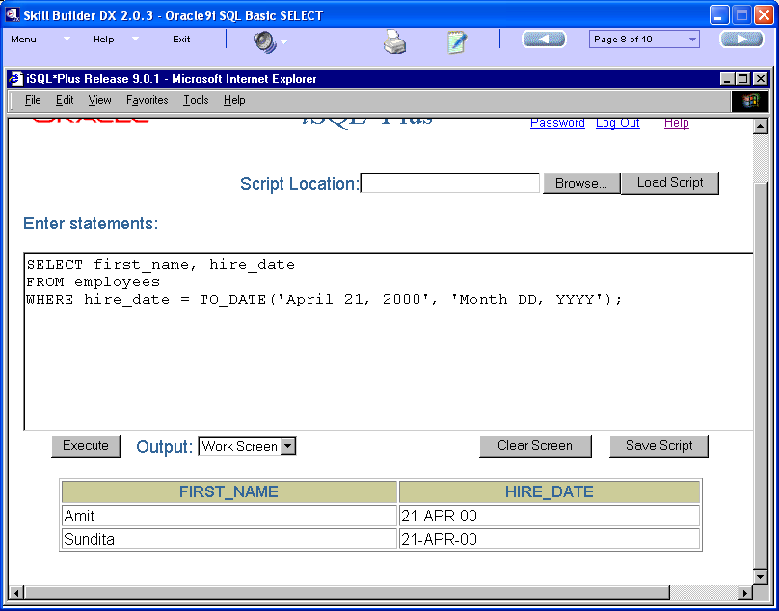

Slide 43
Syntax:
TO_TIMESTAMP(string1, [ format_mask ] )
In Oracle/PLSQL, the to_timestamp function converts a string to a timestamp,where
  string1 is the string that will be converted to a timestamp
  format_mask is optional. This is the format that will be used to convert string1 to a timestamp.

Slide 44
Example:
to_timestamp('2003/12/13 10:13:18', 'YYYY/MM/DD HH:MI:SS')
Return '13-DEC-03 10.13.18.000000000 AM' as a timestamp value.
to_timestamp('2003/DEC/13 10:13:18', 'YYYY/MON/DD HH:MI:SS')
Return '13-DEC-03 10.13.18.000000000 AM' as a timestamp value.

Slide 45
These parameters can be used in many combinations.
Parameter
Explanation
YYYY
4-digit year
MM
Month (01-12; JAN = 01).
MON
Abbreviated name of month.
MONTH
Name of month, padded with blanks to length of 9 characters.
DD
Day of month (1-31).
HH
Hour of day (1-12).
HH12
Hour of day (1-12).
HH24
Hour of day (0-23).
MI
Minute (0-59).
SS
Second (0-59).

